Slide 1
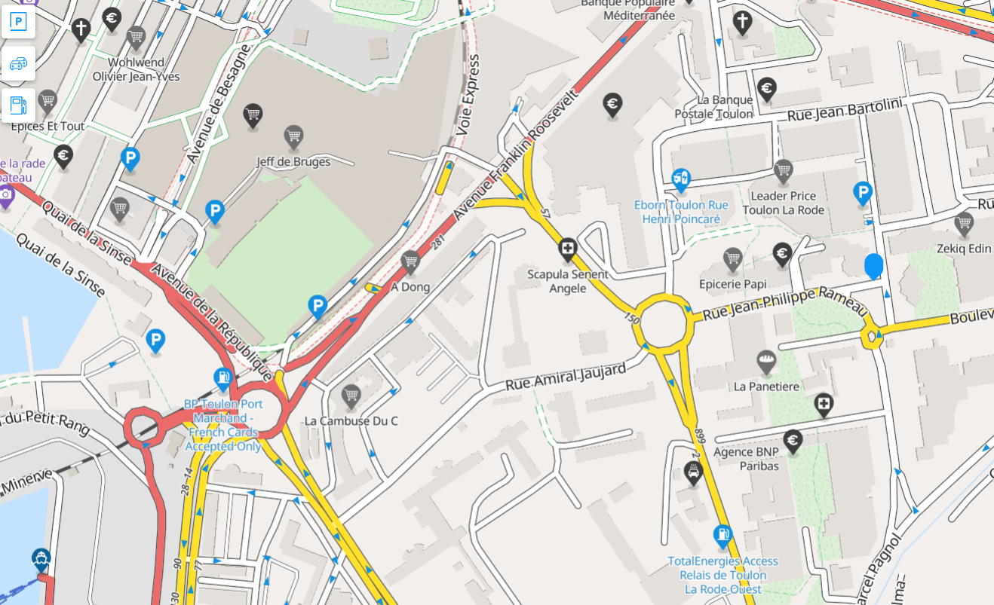
Rue Vincent Scotto
Salle Frank ARNAL

